Slide 1
Designing a Cloud-Based Inventory Management System for Azura's E-commerce Platform on AWS
-Pooja Sri v
192210152

Slide 2
AWS- Amazon web services
AWS is Amazon Web Services, which is like a big toolbox of services provided by Amazon for businesses to use in the cloud.
People use it because it offers a wide range of tools for computing, storage, and networking, making it easier for companies to scale their operations and run their applications without having to manage physical infrastructure.
It's like having a powerful set of tools in the cloud to help businesses grow and innovate.

Slide 3
E-commerce platform on AWS
An e-commerce platform on AWS is like having a virtual store where you can sell products online, but instead of managing everything on your servers, you use Amazon Web Services to host and run your online store.
It provides a reliable and scalable infrastructure to handle things like product listings, customer orders, payments, and inventory management securely in the cloud.
It's a convenient way to set up and operate an online store without worrying about the technical details of server management.

Slide 5
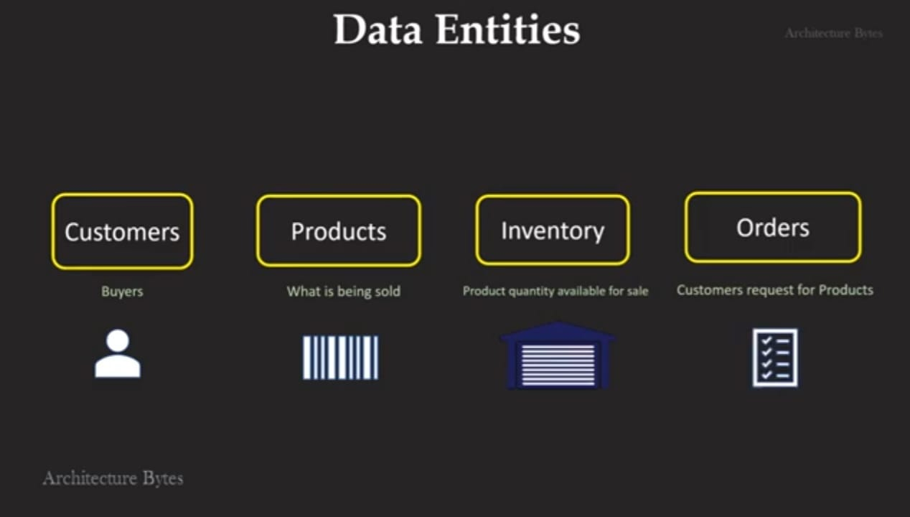
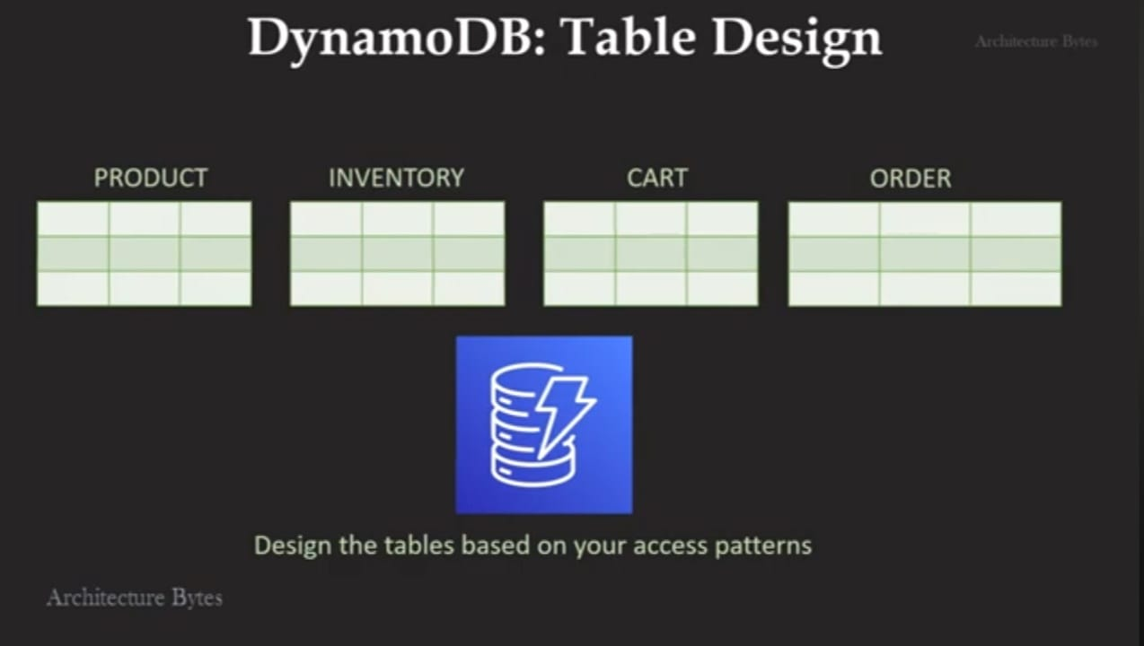
AMAZON WEB SERVICES

Slide 6
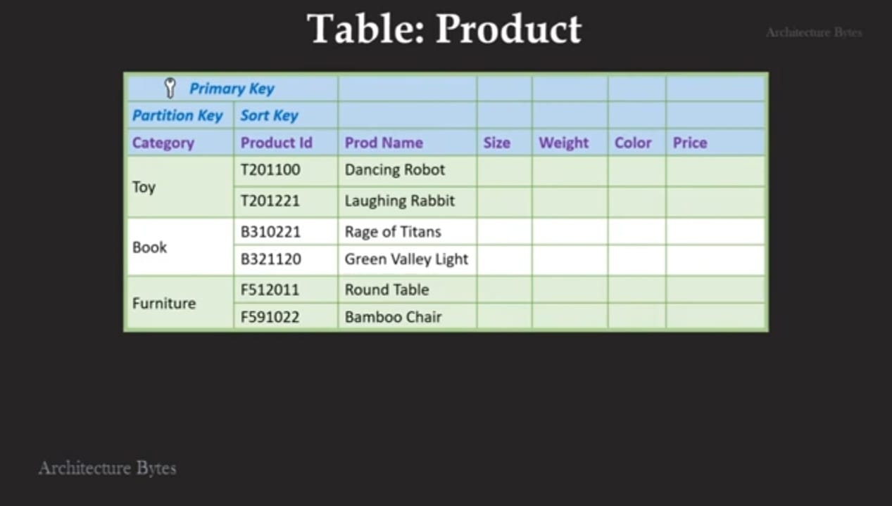
DATABASE

Slide 7
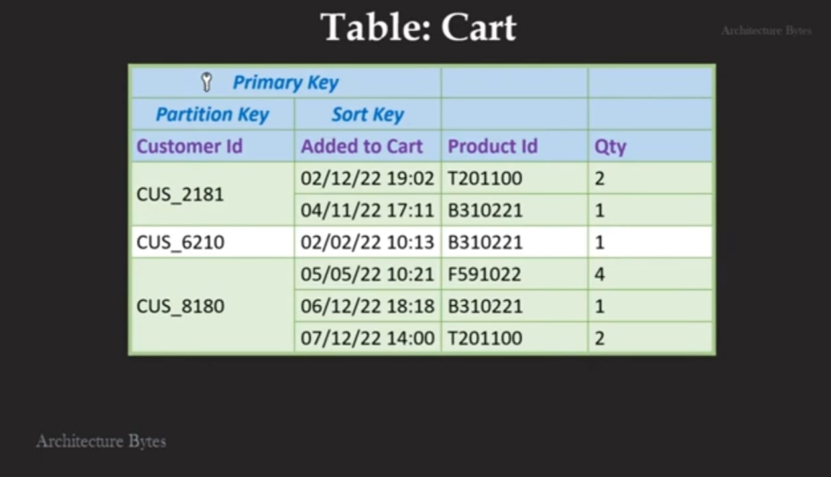
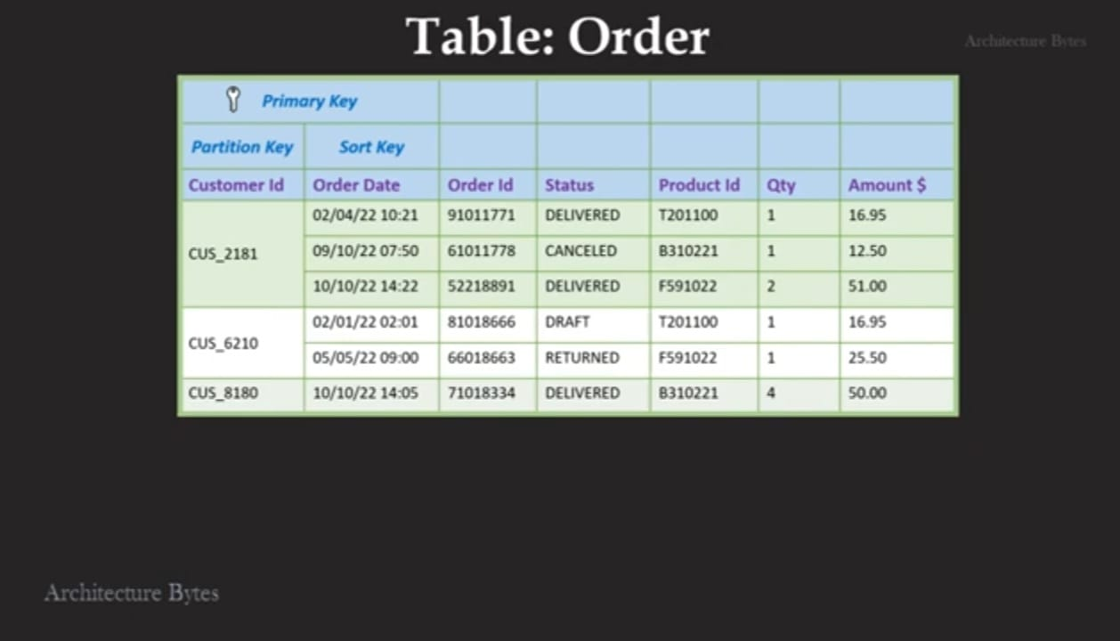
USE CLOUD BASED MANAGEMENT TO UPDATE DATABASE IN REAL TIME

Slide 8
FUTURE SCOPE
AWS has a vast future scope as more businesses and industries are moving towards cloud-based solutions.
It is continuously expanding its services and features to meet the evolving needs of customers.
AWS is likely to focus on innovations in areas like artificial intelligence, machine learning, Internet of Things (IoT), and serverless computing.
Additionally, it may enhance its security measures and global infrastructure to cater to a broader range of businesses worldwide. Overall, the future looks promising for AWS with a strong emphasis on technological advancements and customer-centric solutions.

Slide 9
CONCLUSION
Implementing a cloud-based inventory management system for Auras' e-commerce platform on AWS would boost efficiency, accuracy, and customer satisfaction.
It streamlines inventory control, minimizes errors, and enhances order processing. By leveraging AWS services, Auras can achieve secure data management, real-time updates, and seamless integration with their online store.
In essence, integrating a cloud-based inventory system on AWS for Auras' e-commerce platform would optimize operations and elevate the overall shopping experience.

Slide 10
THANK YOU

